Slide 1
A Dog’s Life
Proposal for Website

Slide 2
Site Map
Home Page
Grooming Services
Map to Store
Contact Information
How to Select a Good Pet

Slide 3


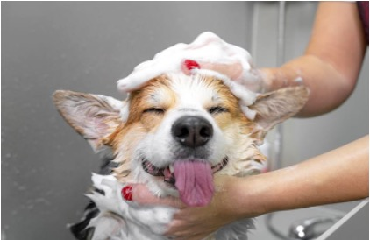




Home Page
A Dog’s Life
HOME
GROOMING SERVICES
MAP TO STORE
CONTACT INFORMATION
A Dog’s Life
GROOMING SERVICES
GROOMING SERVICES
HOME
GROOMING SERVICES
Providing a clean and happy life for your pet!
MAP TO STORE
CONTACT INFORMATION
The staff here is focused on improvement, working each and every day to learn something new. All the animals that stay with us have a great time!
LEARN ABOUT OUR SERVICES
Providing a clean and happy life for your pet!
Reviews From Our Clients
The staff here is focused on improvement, working each and every day to learn something new. All the animals that stay with us have a great time!
Amy M. - 2/23/2023
Amy M. - 2/23/2023
Great service, friendly people!
Great service, friendly people!
The 5th edition of the popular textbook features HTML5 into two-page treatments…
The 5th edition of the popular textbook features HTML5 into two-page treatments…
Write your review!
LEARN ABOUT OUR SERVICES
Read full review >
Read full review >
Reviews From Our Clients
$©$2023 A Dog’s Life – All Rights Reserved.
7620 E McKellips Rd, Scottsdale, AZ 85257 | (602) 662-6262 | adogslife@gmail.com
Amy M. - 2/23/2023
Great service, friendly people!

Slide 4

Grooming Services
A Dog’s Life
HOME
GROOMING SERVICES
MAP TO STORE
CONTACT INFORMATION
A Dog’s Life
GROOMING SERVICES
GROOMING SERVICES
HOME
GROOMING SERVICES
MAP TO STORE
CONTACT INFORMATION
Grooming Services
For dogs of any type, and any size! Full grooming and individual service options available.
Grooming Services
For dogs of any type, and any size!
Full grooming and individual service options available.
Full Groom
Bath & Brush
Nail Trimming
$18
Coat wash with premium shampoo
Full brush and blow dry
Full haircut or trim
Ear cleaning
Nail trimming
Coat wash with premium shampoo
Full brush and blow dry
Ear cleaning
Nail trimming
Full Groom
Ear Cleaning
$5
Coat wash with premium shampoo
Full brush and blow dry
Full haircut or trim
Ear cleaning
Nail trimming
Teeth Brushing
$10
Small Dogs
Medium Dogs
Large Dogs
$62
$72
$92
Small Dogs
Medium Dogs
Large Dogs
$42
$52
$72
Face Trim
$10 - $20
Small Dogs
Medium Dogs
Large Dogs
$62
$72
$92
BOOK AN APPOINTMENT
BOOK AN APPOINTMENT
Sanitary Trim
$10 - $20
BOOK AN APPOINTMENT
$©$2023 A Dog’s Life – All Rights Reserved.
7620 E McKellips Rd, Scottsdale, AZ 85257 | (602) 662-6262 | adogslife@gmail.com
Bath & Brush

Slide 5
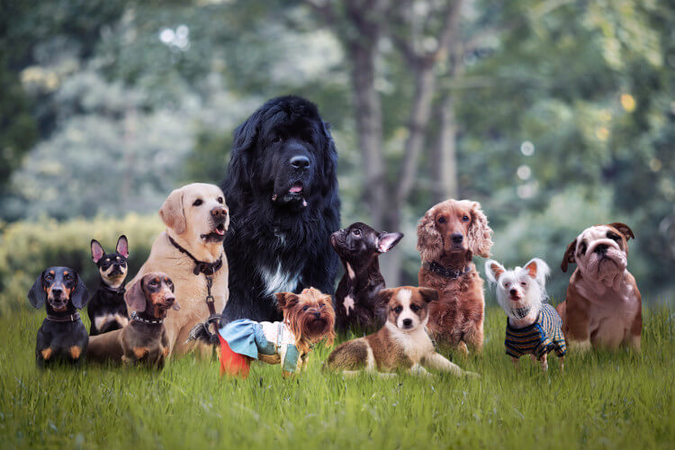
Grooming Services – How to Select a Good Pet
A Dog’s Life
HOME
GROOMING SERVICES
MAP TO STORE
CONTACT INFORMATION
A Dog’s Life
GROOMING SERVICES
GROOMING SERVICES
HOME
GROOMING SERVICES
Looking to get a furry friend? Here’s a Guide to Select a Good Pet
MAP TO STORE
CONTACT INFORMATION
Looking to get a
furry friend? Here’s a Guide to Select a Good Pet
1. Do you (or someone you live with) have allergies?
Safety comes first, and you would not want allergic reactions to always be happening. You can choose to have “low-allergen” pets to avoid such problems.
1. Do you (or someone you live with) have allergies?
Safety comes first, and you would not want allergic reactions to always be happening. You can choose to have “low-allergen” pets to avoid such problems.
$©$2023 A Dog’s Life – All Rights Reserved.
7620 E McKellips Rd, Scottsdale, AZ 85257 | (602) 662-6262 | adogslife@gmail.com

Slide 6
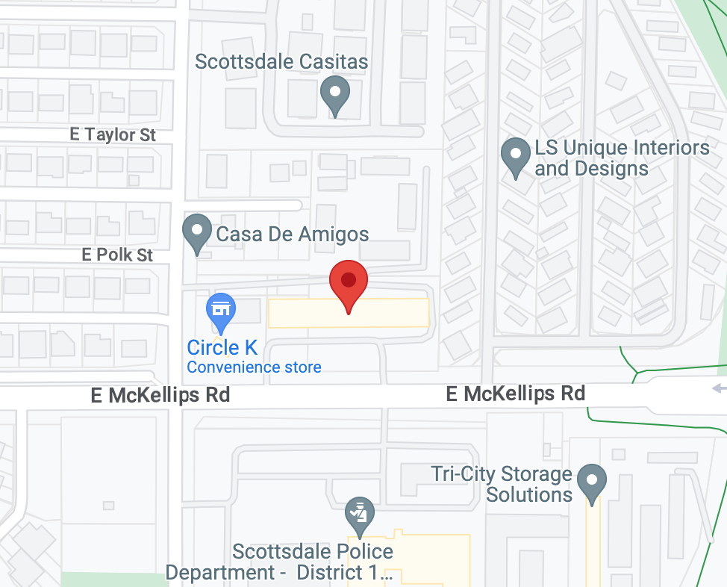
Map to Store
A Dog’s Life
HOME
GROOMING SERVICES
MAP TO STORE
CONTACT INFORMATION
A Dog’s Life
GROOMING SERVICES
GROOMING SERVICES
HOME
GROOMING SERVICES
MAP TO STORE
CONTACT INFORMATION
Visit our store!
A Dog’s Life Grooming Services
7620 E McKellips Rd,
Scottsdale, AZ 85257
Operating Hours
Visit our store!
Mon - Fri
Sat
Sun
08:00 am – 05:00 pm
By appointment only
Closed
A Dog’s Life Grooming Services
7620 E McKellips Rd,
Scottsdale, AZ 85257
Operating Hours
Mon - Fri
Sat
Sun
08:00 am – 05:00 pm
By appointment only
Closed
$©$2023 A Dog’s Life – All Rights Reserved.
7620 E McKellips Rd, Scottsdale, AZ 85257 | (602) 662-6262 | adogslife@gmail.com

Slide 7

Contact Information
A Dog’s Life
HOME
GROOMING SERVICES
MAP TO STORE
CONTACT INFORMATION
A Dog’s Life
GROOMING SERVICES
GROOMING SERVICES
HOME
GROOMING SERVICES
Book an appointment
MAP TO STORE
CONTACT INFORMATION
* Indicates required field
Contact us!
Contact us!
Name *
7620 E McKellips Rd,
Scottsdale, AZ 85257
7620 E McKellips Rd,
Scottsdale, AZ 85257
First
Last
Email *
(602) 662-6262
(602) 662-6262
Pet Breed *
Pet Size *
adogslife@gmail.com
adogslife@gmail.com
Select
Grooming Service(s)*
Book an appointment
Full Groom
Bath & Brush
Teeth Brushing
Nail Trimming
Ear Cleaning
Face Trim
Sanitary Trim
* Indicates required field
Name *
First
Last
+ add pet
Email *
SUBMIT
Pet Breed *
Pet Size *
$©$2023 A Dog’s Life – All Rights Reserved.
7620 E McKellips Rd, Scottsdale, AZ 85257 | (602) 662-6262 | adogslife@gmail.com
Select
Grooming Services*

